Slide 1

Image Reconstruction using Deep Learning Techniques

Slide 2

Image Reconstruction using Deep Learning Techniques

Slide 3
Introduction
Developing a model using Convolutional Neural Networks (CNNs) and Generative Adversarial Networks (GANs) to reconstruct partially occluded images.
Involves data preprocessing, model training, and evaluation using a celebrity image dataset.
Performance metrics: PSNR and SSIM to ensure accuracy.

Slide 4
Problem Statement
Challenges of image occlusion in computer vision
The need for effective image reconstruction techniques

Slide 5
Objectives
Develop a model to accurately reconstruct missing parts of an image
Focus on CNNs and GANs for their effectiveness in image processing

Slide 6
Abstract
Use of deep learning (CNNs and GANs) for reconstructing partially occluded images
Dataset, preprocessing, model training, and evaluation metrics (PSNR and SSIM)

Slide 7
Data Preparation
Dataset:
CelebA dataset with celebrity images
Preprocessing steps: resizing, normalizing, and applying random masks

Slide 8
Data Preprocessing
Resizing images to 256x256 pixels
Normalizing pixel values
Applying random masks for occlusion simulation

Slide 9
Features and Targets
Features:
Images resized and normalized to ensure consistency
Targets:
The same as input images for reconstructing occluded parts

Slide 10
Model Architecture
CNN Model Architecture:
Input layer (256x256x3)
Two convolutional layers with ReLU and batch normalization
Upsampling layer
Final convolutional layer with sigmoid activation

Slide 11
Methodology
Training:
Process of training neural networks
Model compilation and training steps

Slide 12
Model Compilation
Optimizer: Adam
Loss Function: Mean Squared Error (MSE)
Metrics: Accuracy, PSNR, SSIM

Slide 13
Model Training
Fit method for training
Number of epochs and validation data usage

Slide 14
Model Evaluation
Importance of evaluating on unseen data
Metrics to assess performance

Slide 15
CNN Model Results
Training for 10 epochs
Achieved 95% accuracy on validation set

Slide 16
GAN Model Results
Training for 10,000 epochs.
Discriminator and generator dynamics.
High visual fidelity of reconstructed images

Slide 17
Steps in Image Reconstruction
Applying random masks
Image reconstruction process
Evaluation using PSNR and SSIM

Slide 18
Performance Metrics
PSNR: Peak Signal-to-Noise Ratio
SSIM: Structural Similarity Index

Slide 19
Results Visualization
Visualizing Results:
Comparison of original, masked, and reconstructed images

Slide 20
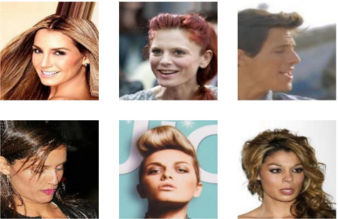
Original Images
Ground truth for training and evaluation

Slide 21
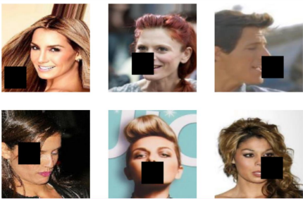
Occluded Images
Input images with intentional occlusions

Slide 22
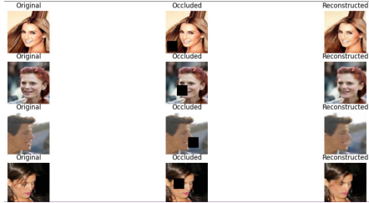
RECONSTRUCTED IMAGES:
Outputs from CNN and GAN models
Evaluating reconstruction quality

Slide 23


